Slide 1
Xbox Graphics
Xfest
August 23, 2000
Kyle Johns, Program Manager
Andrew Goossen, Development Lead

Slide 2
Agenda
Xbox graphics features and performance
Xbox D3D implementation
Xbox D3D extensions
Xbox graphics tools and resources

Slide 3
Xbox Graphics Features
Xbox fully supports the latest features in hardware, including the following:
  Cube environment mapping
  Particle systems
  Hardware transform and lighting
  Bump mapping
  Shadows
  Programmable pixel and vertex shaders
  Vertex blending
  Curved surfaces

Slide 4
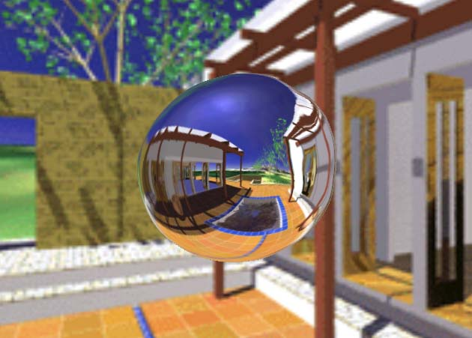
Cube Environment Mapping
Allows reflections and refractions

Slide 5
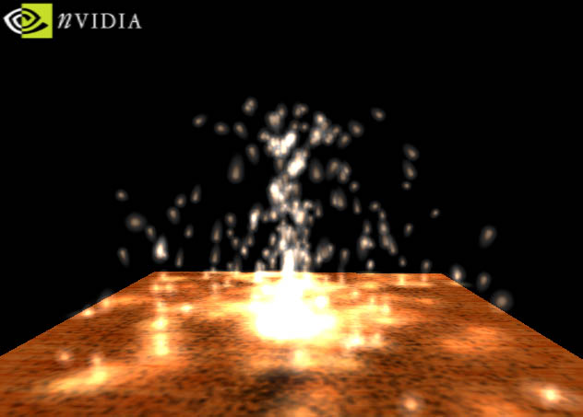
Particle Systems

Slide 6
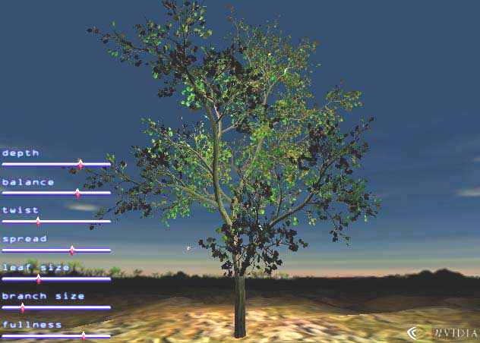
Hardware Transform and Lighting
Allows scenes with high polygon count

Slide 7
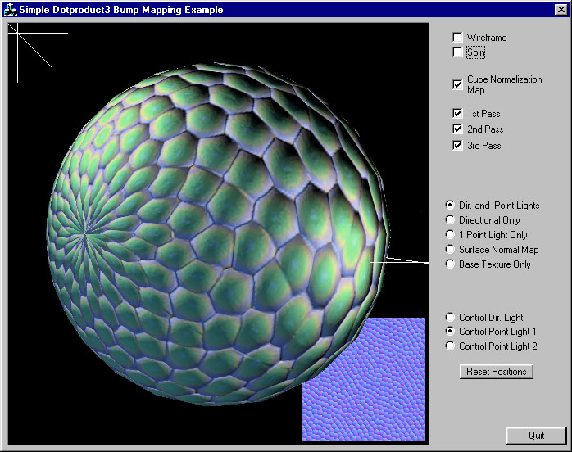
Bump Mapping
Allows per-pixel lighting detail

Slide 8
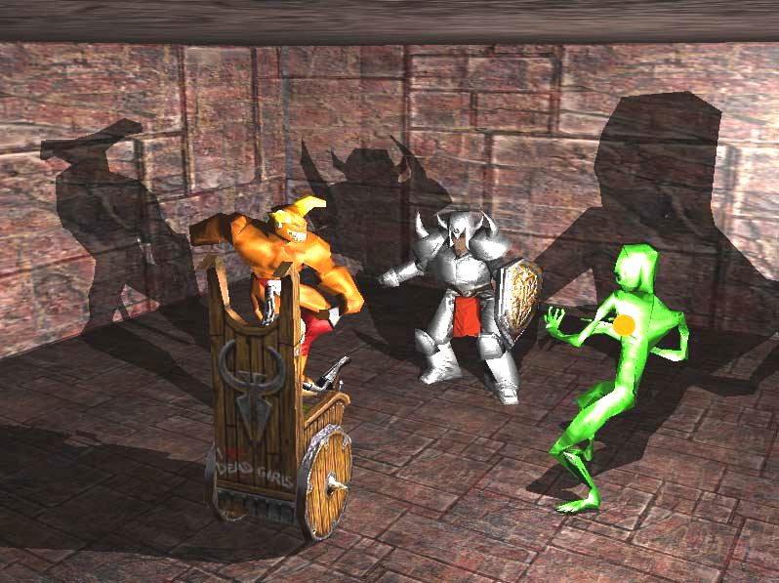
Shadows

Slide 9


Programmable Shaders

Slide 10

Vertex Blending
Allows vertices to be blended between two (or more) transforms

Slide 11

Curved Surfaces

Slide 12
Xbox Graphics Performance
Custom NVIDIA GPU
  Peak triangle rate: 125 million Gouraud-shaded, two-texture triangles per second
    With 1 hardware light — 62.5 million tri/sec
    With 8 hardware lights — at least 8 million tri/sec
  Peak fill rate: 1 gigapixel per second
    Enough to touch each pixel 50 times per 60-Hz frame at 640x480 resolution
    Up to 4 gigapixels per second with occlusion culling

Slide 13
Xbox Graphics Performance
Textures
  Four simultaneous textures supported
    Two at full speed
  Compressed textures supported
    8:1 ratio possible

Slide 14
Xbox Graphics Performance
Actual polygon and fill rates will be determined by usage
Memory bandwidth can be a constraint
  6.4 GB/s available
  Compressed vertices and textures can help
  Efficient use of the vertex cache important
    Triangle strips
    Properly organized triangle lists
Efficient parallel use of CPU and GPU is critical

Slide 15
Xbox Graphics Performance
Michael Abrash wrote an assessment of Xbox graphics performance:
Dr. Dobb's Journal, August 2000 http://www.ddj.com/articles/2000/0008/0008a/0008a.htm?topic=graphics

Slide 16
Direct3D on Xbox
Direct3D will be the primary graphics API on Xbox
  Based on DX8
  Some architecture and feature differences from PC version of DX8

Slide 17
Xbox D3D Overview
Graphics goals:
  Make Xbox D3D as small and fast as possible
  Expose everything the hardware can do
  Make it easy to port between Xbox and PC

Slide 18
DX8 Implementation
Full DX8 implementation
Xbox-specific extensions to cover h/w features not exposed in DX8
Newly written DX8 run-time and driver are integrated
  World’s first DX8 ICD
No software anything (no Refrast, no ProcessVertices())
No lost surfaces ever

Slide 19
DX8 Implementation
Static .LIB
No COM, no vtables
  Calling code looks the same (for example,
  pDevice->Clear()), but:
    Less call overhead
    Linker can remove unused code paths
    Can support inlining (e.g., SetRenderState?)
  QueryInterface() not supported
Two .LIB versions: debug and retail
  Only debug does parameter checking, etc.

Slide 20
DX8 Implementation
“Pure” DX8 device
  Device state is not shadowed in software, so no GetTransform, GetRenderState, etc.
  Will add heavy-weight state queries in the future
    Will query hardware, and so will force push buffer flush
Full D3DX will be supported
  Except font routines

Slide 21
Font Support
Will provide simple bitmap glyph output routines, with source
  Unicode, supports Kanji
  Tool to create bitmap glyphs from GDI fonts
Will provide TrueType rasterizer .LIB
  If run-time scalable fonts needed
  Will have TrueType fonts on disk

Slide 22
Display
Xbox supports NTSC/PAL/SECAM and HDTV
  TV encoder scales and filters for NTSC/PAL/SECAM
    1-2-1 flicker filter default for NTSC
    Various modes supported up to 720x480
  TV encoder is bypassed for HDTV
    No fall-back to NTSC when hooked up via HDTV connectors, so no back-end scaling

Slide 23
Games Must Work on HDTV
Can optionally support wider field-of-view and resolutions of HDTV
Minimally, game can support 640x480 and:
  DAC will automatically letterbox for HDTV
    Black bands on left and right edges of screen
    Lets pixel aspect ratio be 1:1 on both HDTV and NTSC
  Or mode will be set to 720x480 and middle 640 used
    Pixel aspect ratio not 1:1
    Some memory waste
New API to query whether NTSC/PAL/SECAM/HDTV connection

Slide 24
Optional NTSC Wide-Screen Support
New API to query whether user wants wide-screen 16:9 support via NTSC connection
Unlike HDTV, this support is optional
  User can flick a button on TV to support 4:3

Slide 25
Field Rendering
Hope to support field rendering
  Game has to guarantee 60-Hz updates
  Can allocate frame buffer and Z at 640x240
    Potentially very helpful for full-scene anti-aliasing
  Potential complications with flicker-filter and FSAA filter kernel
  Not possible with HDTV connection
    HDTV requires progressive
    So field rendering can’t always be used

Slide 26
Memory Management
Xbox is UMA
  But there’s no AGP-style GART or equivalent, so:
    Writable surfaces have to be physically contiguous
    Readable surfaces (effectively) have to be physically contiguous
  Physical memory is partitioned into four regions
    Determines memory page interleave
  Eight programmable regions control swizzling areas

Slide 27
Memory Management
Xbox memory manager can move physical pages when allocating contiguous regions
  MM can move unlocked VM pages to make room
But game has best knowledge of memory usage, so:
  Xbox will support an optional plugable memory manager
    All OS allocations go through MM
    D3D and DSound allocations tagged with types

Slide 28
D3D Objects
Vertex buffers and texture structures will be exposed and documented
  Single DMA can load h/w aligned batch of VBs/textures along with D3D objects
    No per-object CreateTexture/VertexBuffer – Lock – memcpy – Unlock
    Just point D3D to list and go
Ability to modify textures to change format, location, etc. on the fly

Slide 29
Events and Notifications
Will expose most GPU events
  Vblank interrupt, etc.
In-line read of Vblank count and scan-line
  For fast timing

Slide 30
Demonstration

Slide 31
Xbox D3D Extensions
Direct3D 8.0 does not support full Xbox graphics feature set
Direct3D 8.0 on Xbox will map closely to Xbox hardware
  Pixel shader enhancements
  Vertex state programs
  New compressed vertex attribute formats
  Persistent vertex attributes
  Shadow maps
  Occlusion culling
  Two-sided lighting

Slide 32
D3D Extensions: Pixel Shaders
Changes to Pixel Shader Language Assembler
Modifications to the Pixel Shader Language itself

Slide 33
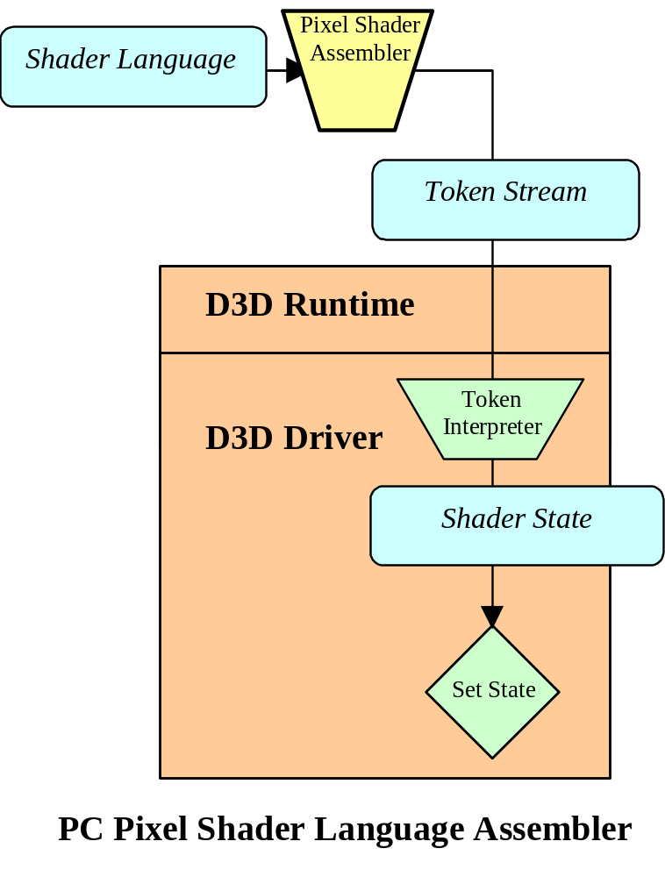
D3D Extensions: D3D 8 Assembler

Slide 34
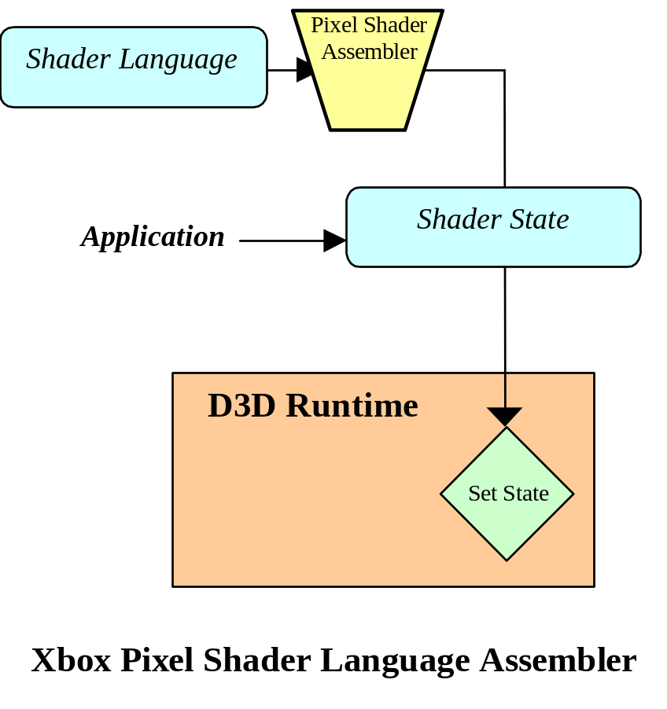
D3D Extensions: Xbox Assembler

Slide 35
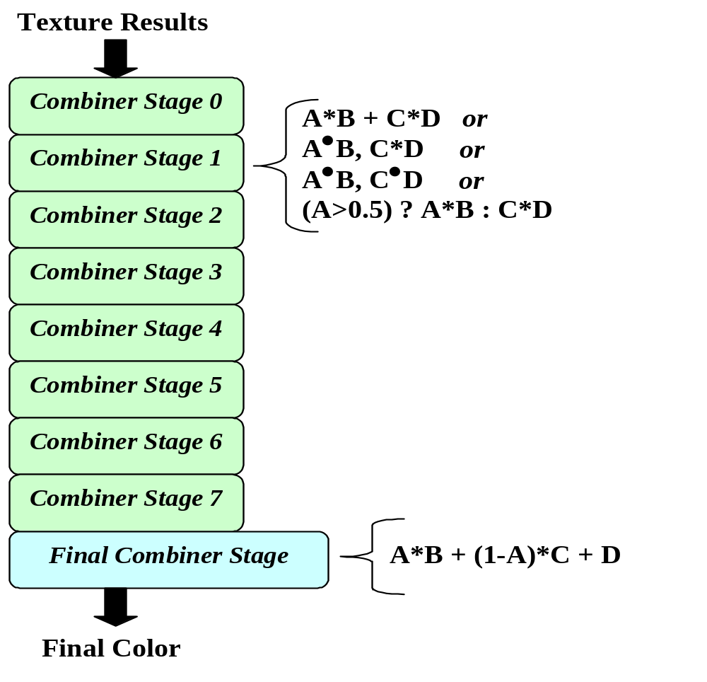
D3D Extensions: NV2A Pixel Combiners

Slide 36
D3D Extensions: New Instructions
Instruction | Description
Mma d0,d1,d2, s0,s1,s2,s3 | Multiply, multiply, add d0 = s0*s1 d1 = s2*s3 d2 = s0*s1 + s2*s3
mmc d0,d1,d2, s0,s1,s2,s3 | Multiply, multiply, compare d0 = s0*s1 d1 = s2*s3 d2 = (r0.a>0.5) ? s0*s1 : s2*s3
dm d0,d1, s0,s1,s2,s3 | Dot and multiply d0 = s0 dot s1 d1 = s2*s3
dd d0,d1, s0,s1,s2,s3 | Dot and dot d0 = s0 dot s1 d1 = s2 dot s3
prod s0,s1 | Load PROD register with s0*s1
frgb s0,s1,s2,s3 | OutputColor.rgb = s0*s1 + (1-s0)*s2 + s3
fa s0 | OutputColor.a = s0.a

Slide 37
D3D Extensions: Other Language Changes
Allow input color registers to be writeable
Add the following registers:
  ZERO — A zero constant
  PROD — A product that can be specified and used in the final combiner stage
  SUM — The sum of the Vertex Color 1 input and the tmp register 0 value; only available for use in the final combiner
  FOG — Contains the fog color

Slide 38
D3D Extensions: Compressed Vertex Attributes
Add support for compressed attribute formats
  Normalized signed shorts — 2 bytes covering
  [-1,1]
    Represent a normal in 6 bytes
    Useful for texture coordinates
  Integer signed shorts — 2 bytes covering [-32768,32767]
    Represents a 4-D position in 8 bytes
  Compressed normals — 32 bits
    11-11-10–bit encoding for nx, ny, nz

Slide 39
D3D Extensions: Vertex Attributes
Add support for persistent vertex attributes
  Allows a specified attribute to apply to a block of vertices
  Reduces bandwidth requirements
Add support for floating point fog attributes
  New FVF format
Add support for floating-point fog output from vertex shaders

Slide 40
D3D Extensions: Shadows
Add support for shadow maps
  Add a texture filter for shadows
  Add a polygon offset
    Allows shadow maps to avoid self-occlusion
    Offset can scale by Z slope

Slide 41
D3D Extensions: Occlusion Culling Feedback
Add support for occlusion culling feedback
  Hardware reports number of pixels that would pass Z test
  Allows a simple test rendering to determine if a complex object is visible

Slide 42
D3D Extensions: Two-Sided Lighting
Enable two-sided lighting
  Add Renderstate
  Add second vertex shader output
  Reduces geometry bandwidth for some models

Slide 43
D3D Extensions: Vertex Shaders
Add support for state programs
  Allows GPU to run small subroutines that don’t output vertex data to the pipe but can store computed results in the constant registers
  Offloads CPU for operations such as matrix inversion or matrix concatenation

Slide 44
D3D 8 Features Not in Xbox
User clip planes
  Can be done with texture address ops
  Costs one texture stage

Slide 45
Graphics Development Tools
Third-party tools
  Modeling tools
    BumpMaker, ShaderAid, BRDF Modeler
  Optimization and Debug
    Vertex shader debugger, 3-D texture compressor
Statistics driver
  Separate driver provided to collect statistics
  Typical statistics:
    Framerate, polys/sec, pixels/sec
    App-time, driver-time, GPU-time per frame
    Texture stats — changes per frame, attributes, etc.

Slide 46
Other Graphics Resources
Xbox ATG group
  Provides samples and performance tips
  Can provide performance assistance
NVIDIA developer relations Web site
  Provides information on hardware
  Provides samples and tools
  http://www.nvidia.com/Developer.nsf

Slide 47
Summary
Please use the feedback form to give us feedback on what you’ve heard!
This talk was given by:
  Kyle Johns and Andrew Goossen, Xbox Graphics
Questions?

